Slide 1
Optimal Execution of portfolio transactions
http://www.courant.nyu.edu/~almgren/papers/optliq.pdf
Stefan Duprey
Notes:
The goal :
To give you new empirical evidence on order submission activity and
price impacts of limit orders at NASDAQ.
We propose a method to predict the optimal size of a limit order conditional on
its position in the book and a given fixed level of expected market impact.

Slide 2
Dilemma facing the maximization of the expected trading revenue
Within a specified period
Of time
Given
Starting Composition
Specified
Final
Composition
High liquidation cost,
Low volatility cost
Trade everything now at a known but high cost
Trade in equal sized packets over a fixed time
Low liquidation cost,
High volatility cost

Slide 3
Dilemma facing the maximization of the expected trading revenue
?
Lower liquidation costs
at the expense
of
greater uncertainty
in final revenue
Utility function
to minimize
Efficient frontier
How to assess uncertainty is subjective
and
a function of the trader’s tolerance for risk

Slide 4
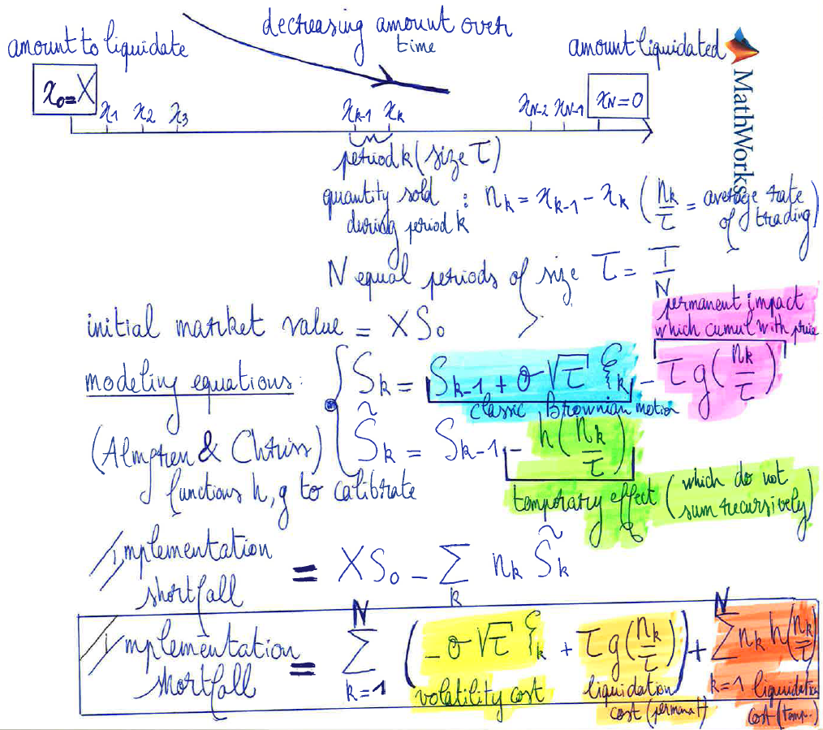
Modeling framework (Almgren & Chriss)

Slide 5
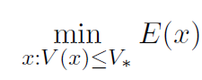
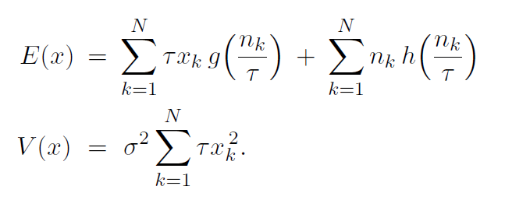
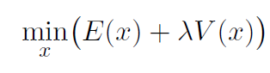
Optimization problem
where x is the liquidation strategy,
E the expected shortfall
and V its variance
(obtained from the previous model)
As for the CAPM pricing model, we get the Lagrange multiplier
Which has a direct financial interpretation : a measure of risk-aversion.
And we minimize the following problem :

Slide 6
Simplifying assumptions :
Independence of returns
Symmetric penalty function for risk
Best strategies are static (they do not depend of the trading path)
Of course, this is naïve, without those assumptions : Dynamic Stochastic Control theory

Slide 7
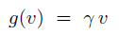
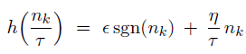
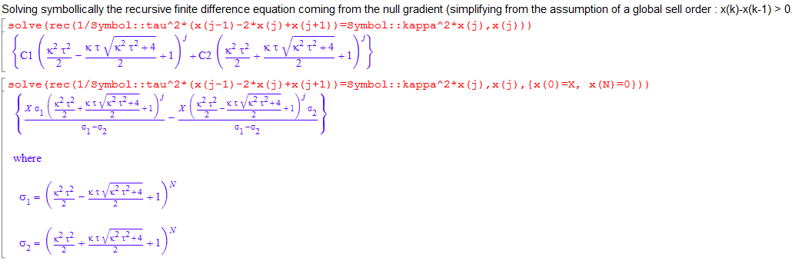
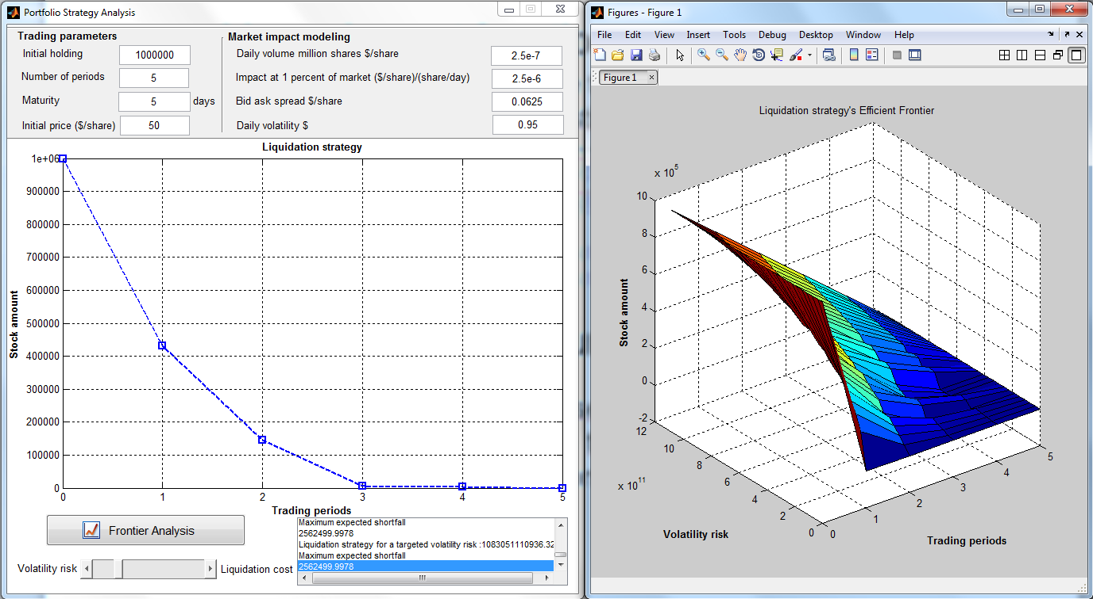
MATLAB and its solutions to solve it !
Linear impact functions
Use the Symbolic toolbox to calculate the
Existing closed form solution :
Non-linear impact functions for risk
No more existing closed form solution
Use the Optimization toolbox to numerically
Compute your solutions

Slide 8
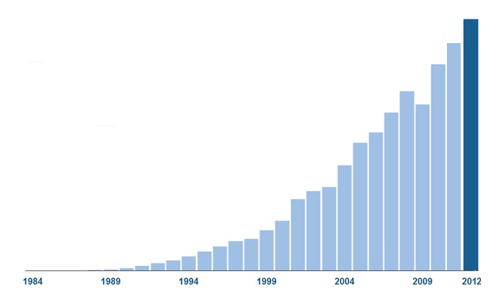

Why MATLAB ?

Slide 9


Slide 10
Language
Of
Technical
Computing
O
Data Mining
Business
Intelligence
Signal
Processing
Quantitative
Finance
Software
Platform
Development
Image Video
Data
Acquisition

Slide 11

Not everybody
would use
MATLAB

Slide 12

In an innovative enterprise,
each one should have access
to MATLAB based applications

Slide 13
Share
your MATLAB algorithms within your enterprise ecosystem

Slide 14
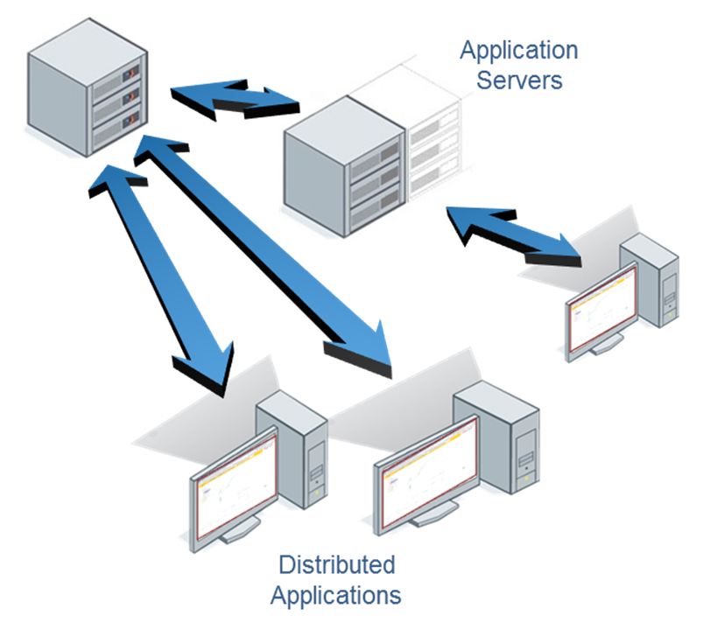






Notes:
MATLAB Production Server lets you run MATLAB programs within your production IT systems, enabling you to incorporate numerical analytics in enterprise IT applications.
Web, database, and enterprise IT applications connect to MATLAB programs running on MATLAB Production Server via a lightweight client library, isolating the MATLAB programs from your production IT system.
Use MATLAB Compiler to package MATLAB programs and deploy them directly to MATLAB Production Server without recoding or creating custom infrastructure to manage them.
MATLAB Production Server runs on multiprocessor and multicore servers, providing low-latency processing of large numbers of concurrent requests. You can deploy the product on additional computer servers to increase the number of concurrent requests the system can handle and to provide redundancy.
The client library supports .NET and Java environments so MATLAB programs running on MATLAB Production Server can be accessed by any application supported by these development environments.

Slide 15
MATLAB Production Server
Directly deploy MATLAB programs into production
Scalable & reliable
Lightweight client
Notes:
MATLAB Production Server lets you run MATLAB programs within your production IT systems, enabling you to incorporate numerical analytics in enterprise IT applications.
Web, database, and enterprise IT applications connect to MATLAB programs running on MATLAB Production Server via a lightweight client library, isolating the MATLAB programs from your production IT system.
Use MATLAB Compiler to package MATLAB programs and deploy them directly to MATLAB Production Server without recoding or creating custom infrastructure to manage them.
MATLAB Production Server runs on multiprocessor and multicore servers, providing low-latency processing of large numbers of concurrent requests. You can deploy the product on additional computer servers to increase the number of concurrent requests the system can handle and to provide redundancy.
The client library supports .NET and Java environments so MATLAB programs running on MATLAB Production Server can be accessed by any application supported by these development environments.

Slide 16
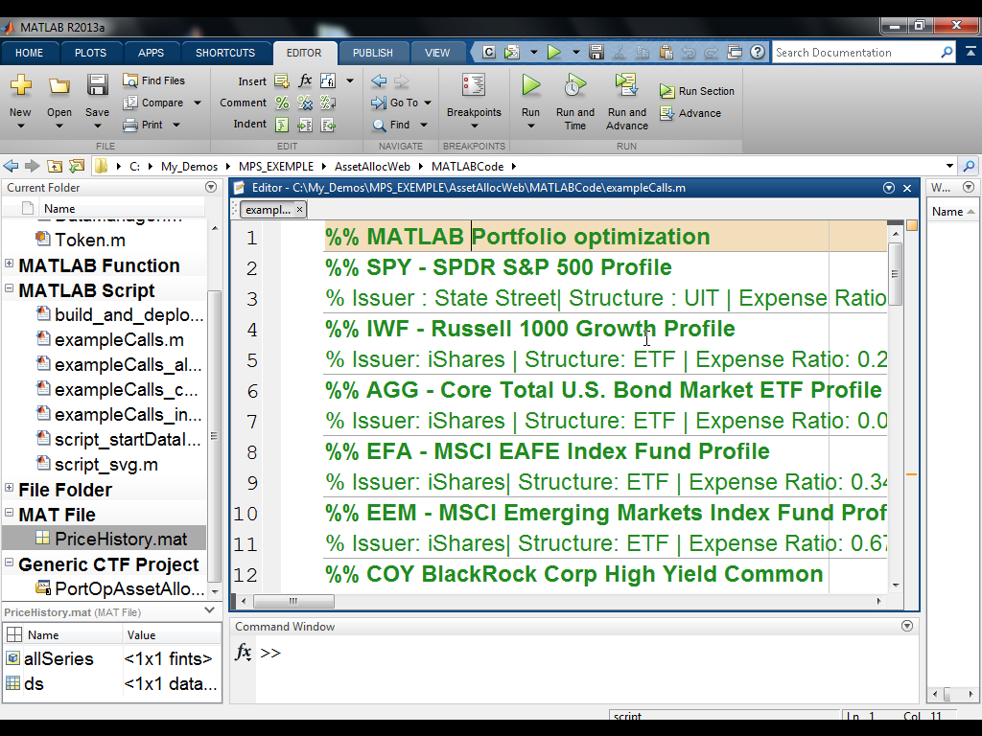
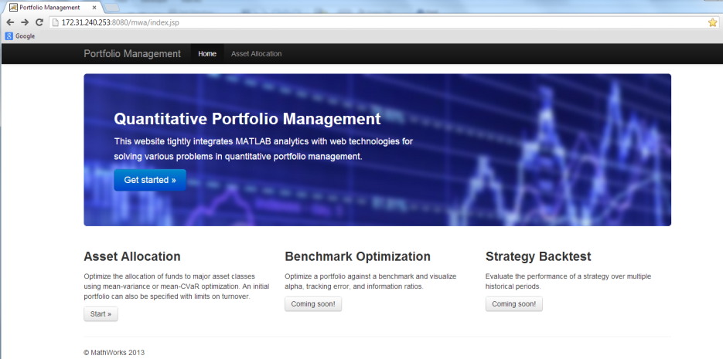
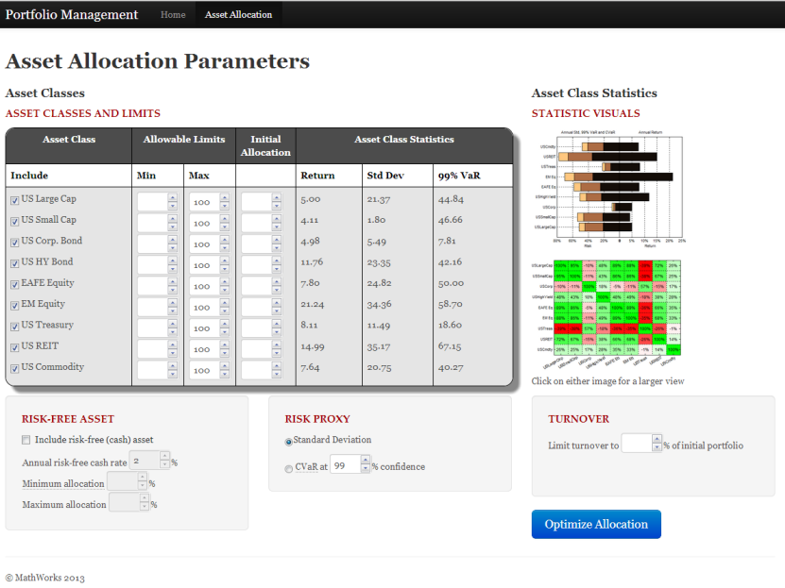
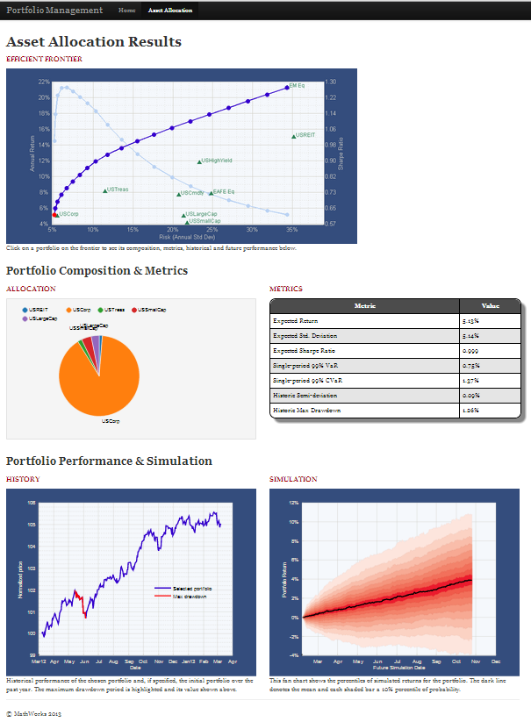
Enterprise Applications
Notes:
Choose a demo from the CRE
Demo can be found in CRE: query by “demo” and “matlab production server”

Slide 17

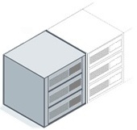


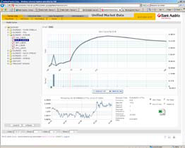



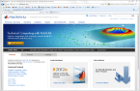
Challenges solved
Directly deploy MATLAB programs into production
Scalable & reliable
Lightweight client
MATLAB Production Server
Application Servers
Distributed
Applications
Notes:
MATLAB Production Server lets you run MATLAB programs within your production IT systems, enabling you to incorporate numerical analytics in enterprise IT applications.
Web, database, and enterprise IT applications connect to MATLAB programs running on MATLAB Production Server via a lightweight client library, isolating the MATLAB programs from your production IT system.
Use MATLAB Compiler to package MATLAB programs and deploy them directly to MATLAB Production Server without recoding or creating custom infrastructure to manage them.
MATLAB Production Server runs on multiprocessor and multicore servers, providing low-latency processing of large numbers of concurrent requests. You can deploy the product on additional computer servers to increase the number of concurrent requests the system can handle and to provide redundancy.
The client library supports .NET and Java environments so MATLAB programs running on MATLAB Production Server can be accessed by any application supported by these development environments.

Slide 18

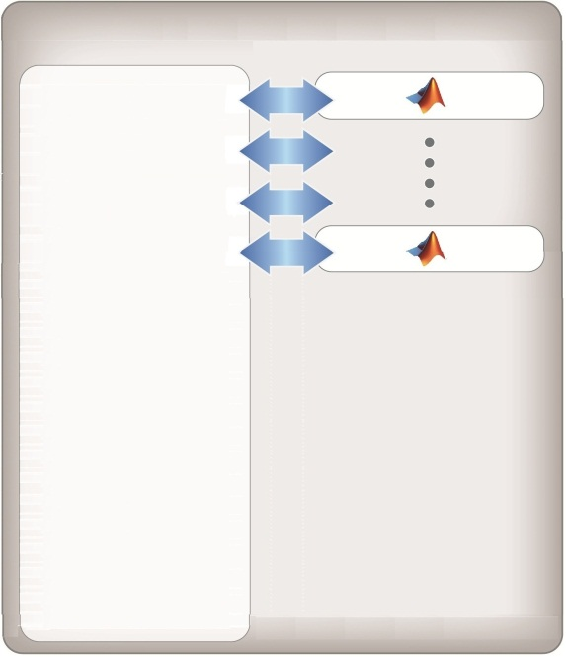

Integration with IT systems
MATLAB
Compiler
Web Applications
MATLAB Production Server
Web
Server
Portfolio
Optimization
Pricing
Desktop Applications
Application
Server
Risk
Analytics
Batch Applications
Database Server
Notes:
MATLAB Production Server provides a numerical backend for any number of IT systems or applications
Numerical algorithms can be deployed directly to MATLAB Production Server using MATLAB Compiler
Web servers (Apache Tomcat or Microsoft IIS) providing browser based content or web services (SOAP/REST) can directly request numerical processing from MATLAB Production Server
Databases which support these types of applications can also make calls for numerical processing initiated by database transactions using triggers and stored procedures
Desktop applications consisting of custom Java or .NET applications or standard applications such as Excel, where add-ins can be created to access numerical functions running on MATLAB Production Server
Server applications running in a batch mode can request numerical processing which may consist of MATLAB code accessing a data repository such as a SQL database or data historian

Slide 19

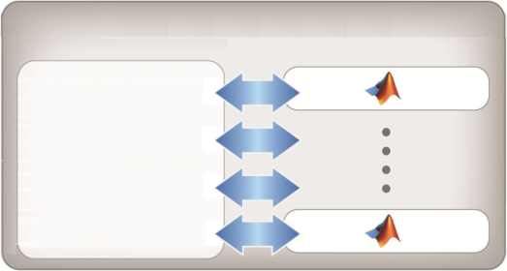

Client Library
Request MATLAB programs running on MATLAB Production Server
.NET and JAVA libraries available
MATLAB Production Server
Request Broker
&
Program Manager
.NET

Slide 20



Production Deployment Workflow
Development
MATLAB
Developer
Algorithm
MATLAB
Compiler
CTF
Enterprise
Application
Developer
Web
Application
MATLAB Production Server
Client
Library
Function Call
Production
MATLAB Production Server
Web
Application
.
.
.
Client
Library
Notes:
Here’s a typical example of how you can take an algorithm developed in MATLAB and integrate it into your production, enterprise application.
Consider a MATLAB developer who creates an algorithm.
(CLICK) Using the MATLAB Compiler, a deployable component is created as a CTF archive.
(CLICK) The CTF can be loaded within a local development MATLAB Production Server for testing
(CLICK) A Java or .NET client library – available as part of the MATLAB Production Server installation – integrates into the enterprise application and is used for making requests of the packaged MATLAB program running on MATLAB Production Server.
(CLICK) As you deploy this to production, the MATLAB Production Server is the numerical computation engine supporting the computational needs of the business application. The business application makes calls to the MATLAB Production Server in response to any MATLAB related processing that’s required to support user requests.
(Needs to be updated) How does the ML Production Server fit into the overall MATLAB “Research to Production” deployment workflow?
MATLAB is used as the research and development tool for creating and validating algorithms by such users as your Quantitative Analyst’s, Financial Engineers, Actuaries or Economists to name a few. (click)
Using the MATLAB compiler and Builder products, a deployable component is created along with a lightweight Java or .NET library. The Java or .NET library is provided to your Application Developers and easily integrated into your Business Application code. (click)
Looking at your production system, The ML Production Server is the numerical computation engine supporting the computational needs of your business application. Your business application will make calls to the ML Production Server in response to any MATLAB related processing that’s required to support user requests. (click)
Your business application is maintained within it’s own infrastructure (click) and the MATLAB components are easily managed and maintained within the reliable and scalable ML Production Server infrastructure. The ML Production Server provides for hot deployment of components and supports multiple versions of the MATLAB runtime (MCR) to support multiple MATLAB deployed components built on different platforms or versions of MATLAB.

Slide 21
Scaled Architecture
DMZ 1
DMZ 2
Web
Server
App
Server
Database Server
Web
Server
App
Server
Web
Server
App
Server
.
.
.
Web
Server
App
Server
Load Balancer
Load Balancer
Load Balancer
MATLAB Production Server
MATLAB Production Server
MATLAB Production Server
Request Broker
&
Program Manager
MATLAB Production Server
Request Broker
&
Program Manager
Request Broker
&
Program Manager
Request Broker
&
Program Manager
License
Manager
Auto Deployment
Repository

Slide 22
Integration Example
Reference client library
Define function signatures
Define connection (server & CTF)
MATLAB Function
function B = BlackScholes(CP,S,X,T,r,v)
d2=d1-v*sqrt(T);
if CP=='c'
B = (S*normcdf(d1)-X*exp(-r*T)*normcdf(d2))-noise;
Enterprise Application
using Mathworks.MATLAB.ProductionServer.Client;
public interface BlkSchInterface
{ double BlackScholes(string C, double S, double X, double T, double r, double v); }
MWClient client = new MWHttpClient();
BlkSchInterface blksch_1 = client.CreateProxy<BlkSchInterface>(new Uri("http://192.168.240.220:9910/BlkSch1"));
double optionprice = blksch_1.BlackScholes("c", BasePrice.Value, 1, 1, 1, Volatility.Value));

Slide 23
Integration with Databases
Optimize numerical processing within databases
Request MATLAB analytics directly from database servers
Trigger requests based upon database transactions
Minimize data handling using Database Toolbox
Database Server
MATLAB Production Server
Enterprise Application
Stored
Procedure
Client
Library
Request Broker
&
Program Manager
Notes:
MATLAB Production Server lets you run MATLAB programs within your production IT systems, enabling you to incorporate numerical analytics in enterprise IT applications.
Web, database, and enterprise IT applications connect to MATLAB programs running on MATLAB Production Server via a lightweight client library, isolating the MATLAB programs from your production IT system.
Use MATLAB Compiler to package MATLAB programs and deploy them directly to MATLAB Production Server without recoding or creating custom infrastructure to manage them.
MATLAB Production Server runs on multiprocessor and multicore servers, providing low-latency processing of large numbers of concurrent requests. You can deploy the product on additional computer servers to increase the number of concurrent requests the system can handle and to provide redundancy.
The client library supports .NET and Java environments so MATLAB programs running on MATLAB Production Server can be accessed by any application supported by these development environments.

Slide 24
Key Take-Aways
Enterprise solution
Be innovative
Cost saving
Quick time-to-market
Easy deployment
Notes:
MATLAB Production Server lets you run MATLAB programs within your production IT systems, enabling you to incorporate numerical analytics in enterprise IT applications.
Web, database, and enterprise IT applications connect to MATLAB programs running on MATLAB Production Server via a lightweight client library, isolating the MATLAB programs from your production IT system.
Use MATLAB Compiler to package MATLAB programs and deploy them directly to MATLAB Production Server without recoding or creating custom infrastructure to manage them.
MATLAB Production Server runs on multiprocessor and multicore servers, providing low-latency processing of large numbers of concurrent requests. You can deploy the product on additional computer servers to increase the number of concurrent requests the system can handle and to provide redundancy.
The client library supports .NET and Java environments so MATLAB programs running on MATLAB Production Server can be accessed by any application supported by these development environments.

Slide 25
Thank You

Slide 26

MATLAB and Simulink are registered trademarks of The MathWorks, Inc. See www.mathworks.com/trademarks for a list of additional trademarks.
Other product or brand names may be trademarks or registered trademarks of their respective holders.”

